Slide 1
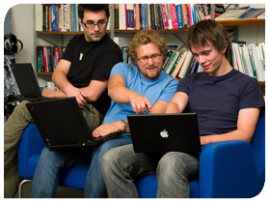



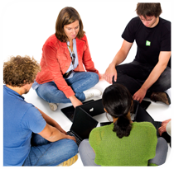

.
Qt in Education
Developing
Qt Apps for
MeeGo

Slide 2


© 2011 Nokia Corporation and its Subsidiary(-ies).
The enclosed Qt Materials are provided under the Creative Commons
Attribution-Share Alike 2.5 License Agreement.
The full license text is available here:
http://creativecommons.org/licenses/by-sa/2.5/legalcode.
Nokia, Qt and the Nokia and Qt logos are the registered trademarks
of Nokia Corporation in Finland and other countries worldwide.

Slide 3
Development Tool-Chain
The MeeGo SDK is built from the following components
  QtCreator – integrated development environment
  Qt Simulator – for running and debugging applications in a simulated environment
  MADDE – for building and debuggin applications in real or emulated environments
Notes:
The MeeGo SDK can be said to consist of three parts:
The Qt Creator integrated development environment
The Qt Simulator, for emulating targets, is an integrated part of Qt Creator
MADDE, the Maemo Application Development and Debugging Environment, is a tool for building for actual targets as well as running emulated environments
Please notice the difference between the simulator, which simulates a target, but executed natively on the host, and the emulator (from MADDE) which executes the code in a virtual (emulated) setup
When using the SDK, all these tools are accessed through Qt Creator. As soon as everything has been setup, everything is easily accessible through graphical tools.

Slide 4
APIs to Use
Qt
Qt Quick
Qt Mobility
Notes:
When developing for MeeGo, Qt is the core API to use for most applications
Of course, there are areas not covered by Qt, but most end user applications should be able to manage with Qt
The core API is the Qt API, but on top of that, both Qt Quick and Qt Mobility are used.
Continues

Slide 5
APIs to Use
Qt
Qt Quick
Qt Mobility
QML – fluid user interfaces!
Direct access to parts of Mobility
Notes:
Qt Quick lets you create stunning user interfaces quickly using QML.
Qt Quick also mix well with Qt Mobility, so common features – for instance, cameras – can be accessed directly from QML. You can get away without writing any glue code.
Continues

Slide 6
APIs to Use
Qt
Qt Quick
Qt Mobility
Sensors, cameras, multimedia,
documents, contacts, location,
calendar, etc
Notes:
Qt Mobility gives you access to the features of the platform such as sensors, cameras, contacts, documents, near field communication, etc
Mobility is also responsible for media playback. On MeeGo, it relies on the gstreamer backend, but from a Qt perspective this is abstracted away and works identically to the backends of Symbian, Windows or OS X

Slide 7
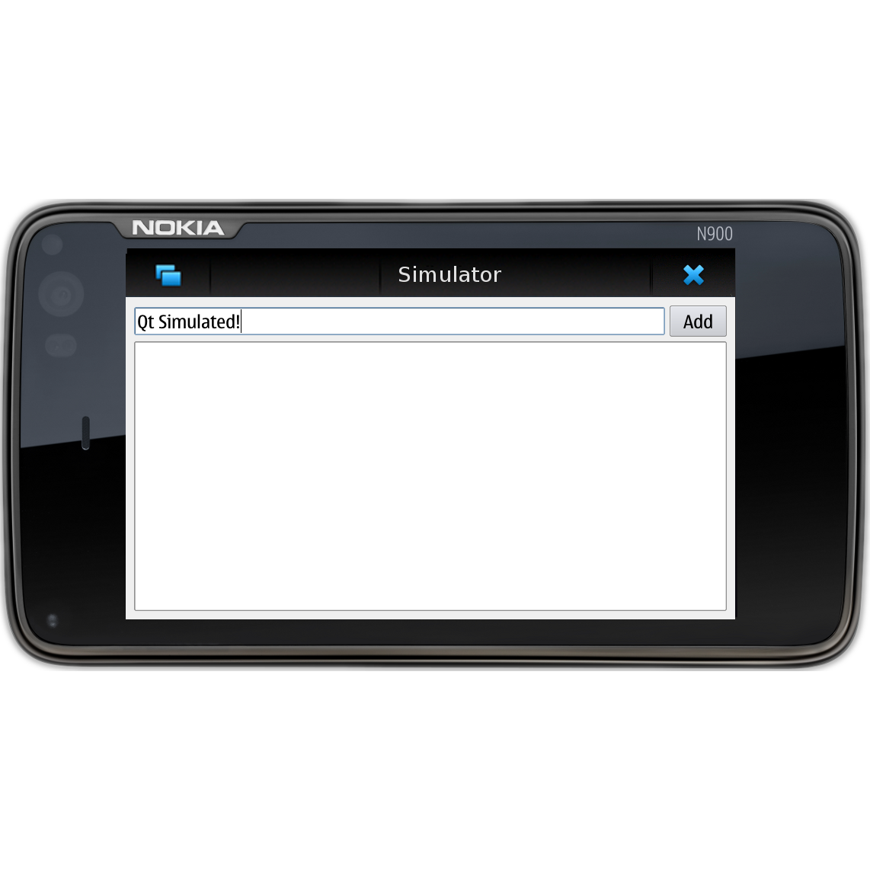
Qt Simulator
Most applications are developed using the Qt Simulator
  Code is executed
  natively – easy
  to debug
  Simulated
  environment
Notes:
The Qt Simulator is an important tool when developing for a device, as opposed to an ordinary desktop appliction.
The Qt Simulator executes the code natively, on the development machine, but simulates environmental constraints such as screen size, orientation, sensors, etc
This makes it easier to perform relevant tests, while still working on the development machine, with all the debugging capabilities that you are used to
Continues

Slide 8
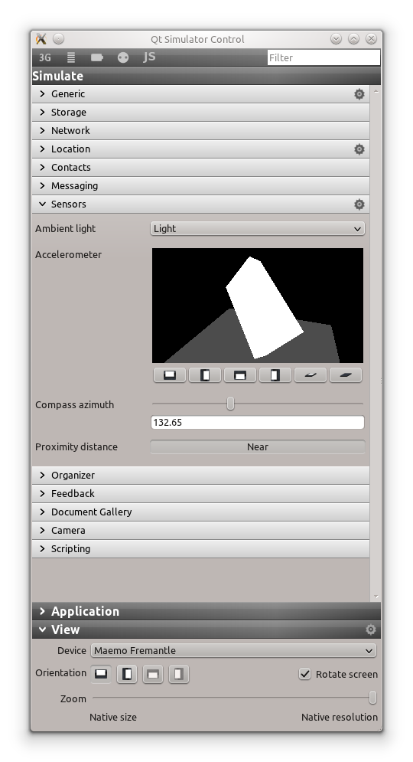
Qt Simulator
The simulator interface exposes much of Qt Mobility
  Can trigger events
  Can modify data
  Can change sensor readings
It is possible to script the simulator
Notes:
When using the simulator, the mobility API back-end is exposed through the simulator user interface. From it, you can:
- Trigger events, such as power state changes
- Modify data, examples are contacts, calendar data, documents
- Change sensor readings, for instance rotating the device in 3D as shown in the screenshot
It is also possible to script the simulator, to be able to repeat given test cases. This makes it possible to automate testing.

Slide 9
Deploying Apps
Build for target
  Results in an RPM-file (an installer package)
  Test, test and test again
  Publish to a store, or through your own channels
Stores
  Intel AppUp
  Nokia Ovi Store
Notes:
When an application has been developed using Qt Simulator, it must be deployed to target for final testing.
To do that, simply build it for target. This will result in an rpm, which is an installation package. This package can then be installed to a target device.
An rpm is an installer package. The interpretation of the term is RedHat Packaging Manager. It is a file containing all of the data to deploy along side scripts for setting up the installation.
Take this rpm and test is thorourgly before making it available to the public. You can publish it either yourself, or though a store.
For MeeGo, the Intel AppUp store (for netbooks and tablets) and Nokia Ovi Store (for handsets)
Continues

Slide 10
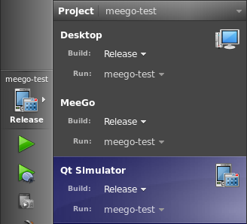
Building RPMs
Simply select the MeeGo target
  The resulting RPM resides in project-build-meego/rrpmbuild
Notes:
To build and package an application into an RPM, simply select the MeeGo target and build.
If you have a project named myproj, your source code lives in /some/path/myproj, then the RPM will end up in the /some/path/myproj-build-meego/rrpmbuild .
Continues

Slide 11
Working with RPMs
When you have the RPM on your target, you can handle it using rpm
  rpm -i myrpm-version.rpm – install
  rpm -e myrpm – erase
  rpm -U myrpm-version.rpm – upgrade
or using zypper
  zypper install myrpm.rpm
  zypper remove myrpm
Notes:
When you have an RPM, you need to transfer it to your target. You can do this using scp, a web server, a USB stick, bluetooth or any other mechanism that you like to use.
When the RPM is at the target, you can install, erase or upgrade it using the command rpm. Or you can use zypper.
Zypper is more powerful, but slightly less direct.
Continues

Slide 12
Repositories
For easier installation and updates, you can place your RPMs in a repository
  User the createrepo tool to create a repository
    http://createrepo.baseurl.org/
  Zypper handles repositories
    zypper ar to add a repository to a target
    zypper refresh to update meta-data from repositories
    zypper search to search all repositories for a package
    zypper info for information about a package
    zypper install to install a package
Notes:
Where zypper really shines is when you use repositories. A repository, shorter: repo, is a collection of RPMs. For instance, all versions, or multiple interdependent RPMs or just a collection of your RPMs.
There is a tool, createrepo, used to create a repo from a set of RPMs. The link provided details this.
When you have an repo setup, you can use zypper to add it to your target's list of repos, search for packages, install packages, but also automatically upgrade all installed packages

Slide 13
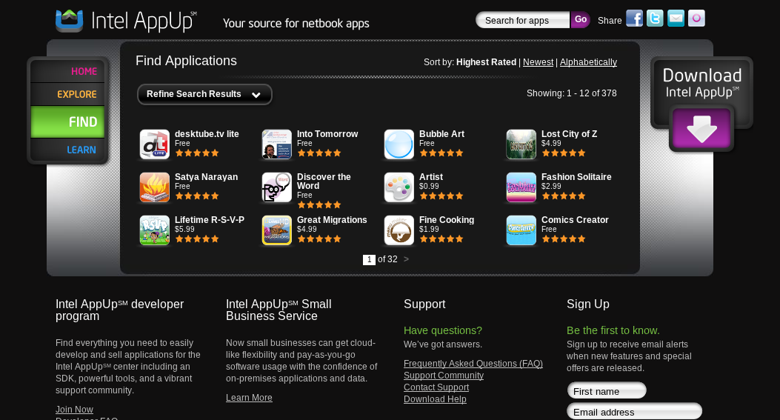
Intel AppUp
On-line app store for MeeGo netbooks and tablets
Possible to sell
applications, or
to distribute
them for free
Apps are validated before they are made available through the store
Notes:
The AppUp store, run by Intel, targets netbooks and tablets.
Through the store, you can sell or give away your creations. All apps available from the store are validated by Intel, so that the end-users can feel safe.

Slide 14
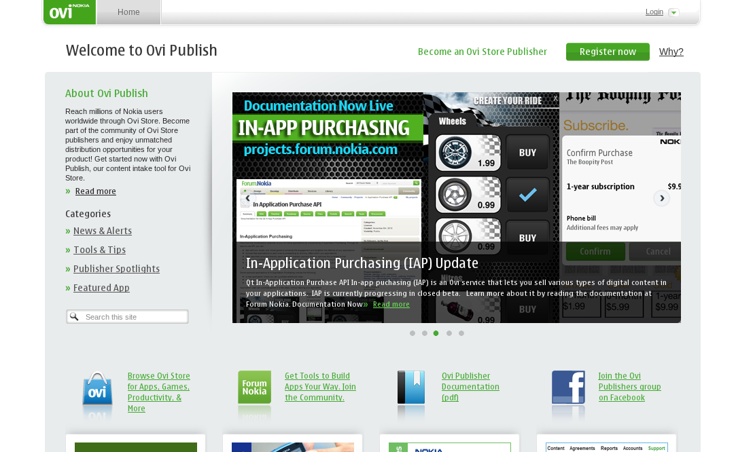
Nokia Ovi Store
On-line app store for MeeGo handsets
Possible to sell
applications, or to
distribute them
for free
Apps are validated
before they are
made available through the store
Notes:
The store targets MeeGo handsets (as well as Symbian devices, also running Qt).
Through the store, you can sell or give away your creations. All apps available from the store are validated by Intel, so that the end-users can feel safe.

Slide 15
Stores in General
Offers a profit sharing program
Provides API for in-app purchases
  Upgrades (try and buy)
  Subscriptions
  Virtual goods (for games, etc)
Handles payments from multiple markets
Notes:
Generally, app stores provide a set of services to you as a developer:
- profit sharing, you get a piece of each application sale
- in-app purchases, e.g. upgrades, subscriptions, virtual goods
For you as a developer, they handle your payments and have deals with carriers and credit card companies for multiple markets – this greatly simplifies the administration for you.

Slide 16
Self-Publish
It is possible to self-publish applications
  Provide RPMs
  Provide access to a repository
What you do not get when self-publishing
  Validated applications
  Support for handling payments
  Easy access through a global store
Notes:
The alternative to using a store is to self-publish. You can do this either by providing users with RPMs or access to a repository
This gives you full control of your distribution. What do not get is:
- validated applications, so the users have to trust you
- payments, you can setup your own infrastructure for this, but you also have to handle the administration
- easy access, the relevant stores are generally shipped with the devices. Here, the user has to find you by other means

Slide 17

Break

Slide 18
An Example Project
Setup a project
  A C++ application with Qt Quick support
Test on desktop
  Basic testing and debugging
Test using simulator
  Testing and debugging with “sensor” input and proper screen resolution
Test using remote (virtual) target
  Final testing on an actual target
Notes:
We will now look at an example project. This is the basic plan.
We start by setting up a project, based on C++, but including Qt Quick support
We will test it on desktop
Then we proceed to test it using the simulator
Finally, we will test it on an actual target
This represent the basic work flow for any Qt project, even though the flow isn't always this linear
Continues

Slide 19
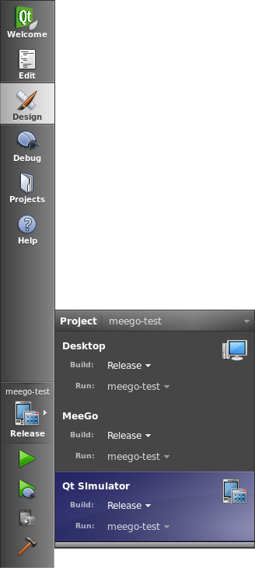
Selecting target
In the left Qt Creator toolbar, the target can be configured
  Select between Release or Debug
  Select target
    Simulator
    Deployment
    Any other target of the project, e.g. local
Notes:
In the lower left corner of QtCreator, just above the compile-and-run button, you can select your target.
You can choose between release or debug builds, as well as which target to build for.
Building a release towards the deployment target actually produces an installable rpm package.
Continues

Slide 20
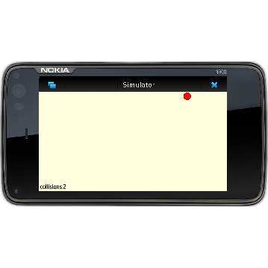
Project Outline
Core application in C++
Qt Quick user interface
C++ slot called from Qt Quick event
Notes:
The application will be a hybrid application, using Qt Quick for the user interface and C++ for the base
What it does is that it bounces a ball around the screen while keeping count of the number of bounces.
The ball and the bouncing are implemented using Qt Quick. The bounce counting is implemented in C++
(This application is also a part of the exercises, thus, no code is included at this stage)
Continues

Slide 21
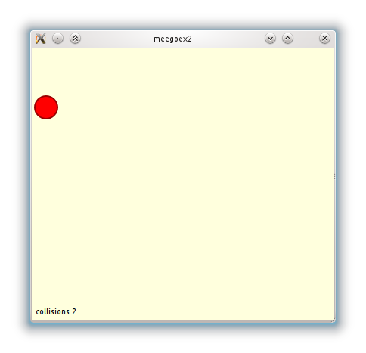
Desktop Experience
Select the Desktop target
Set a breakpoint in the slot
Build and run
Notes:
When you execute the application on the desktop, it will run in an ordinary window.
You can interact, debug and work with the application as you are used to.
Continues

Slide 22
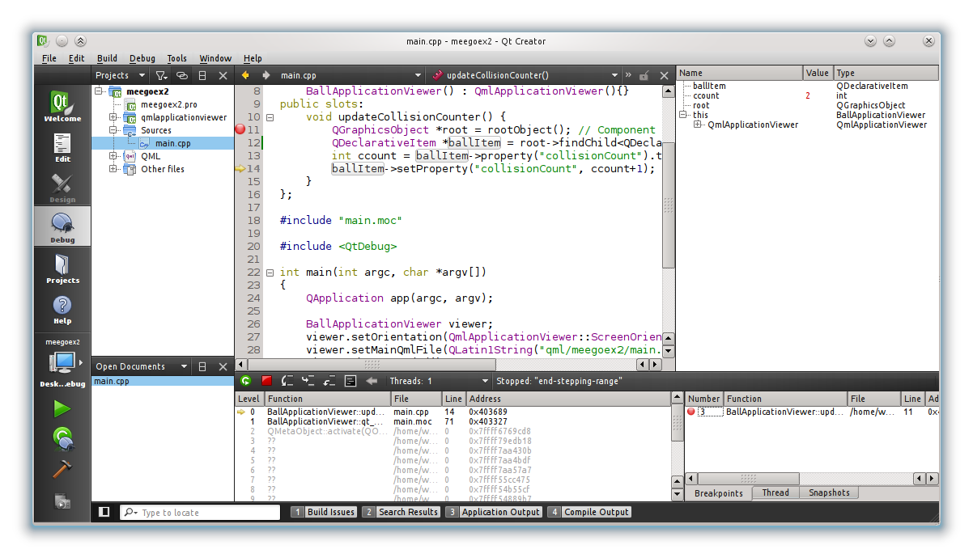
Desktop Debugging
Notes:
Placing a breakpoint in the bounce counter slot lets us debug the application.
We can see the local variables, as well as a call stack
Continues

Slide 23
Simulator Experience
Select the Simulator target
Set a breakpoint in the slot
Build and run
Notes:
Switching the target to the simulator, the application is run in a simulated environment
You can modify sensor values, screen orientation, etc
Continues

Slide 24
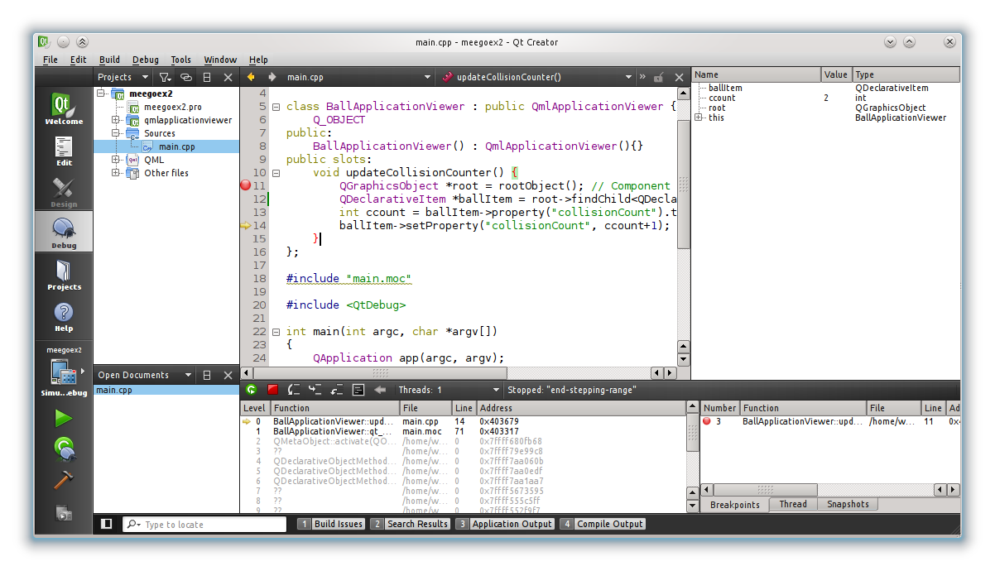
Simulator Debugging
Notes:
As the simulator still executes the code natively on your development machine, the debugger still provides the same abilities
Continues

Slide 25
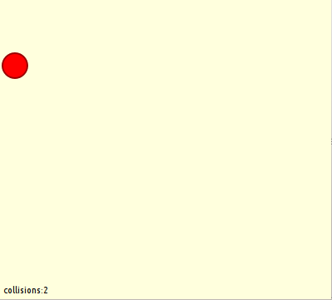
Target Experience
Select the MeeGo target
Set a breakpoint in the slot
Build and deploy
Notes:
On the target, the application runs in a window as defined by the target window manager. This depends on which UX the target is running.
When executing and debugging an application on a target, the debugging session is maintained over a network socket – this is called remote debugging. Qt Creator abstracts this aways and provides the ordinary user interface.
Continues

Slide 26
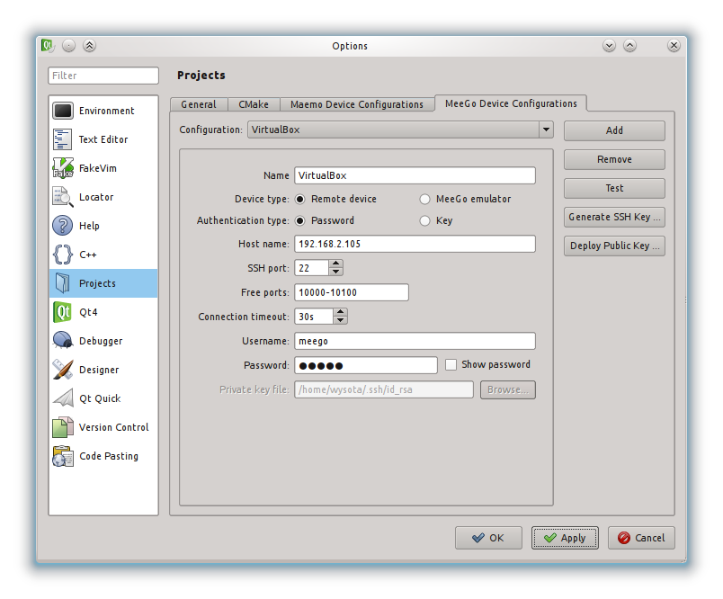
Configure Target
Select target device
  Settings – Project –
  MeeGo Device Configuration
    Host name – IP of remote target
    User name / password
    Target must run sshd
Notes:
Before a remote debugging session can be initiated, Qt Creator must be configured to access the remote target.
The remote target is controlled via ssh, so it must run sshd.
You then setup the Qt Creator environment to login to the target. Provide the target IP, user name, password (alternately an ssh-key)
Continues

Slide 27
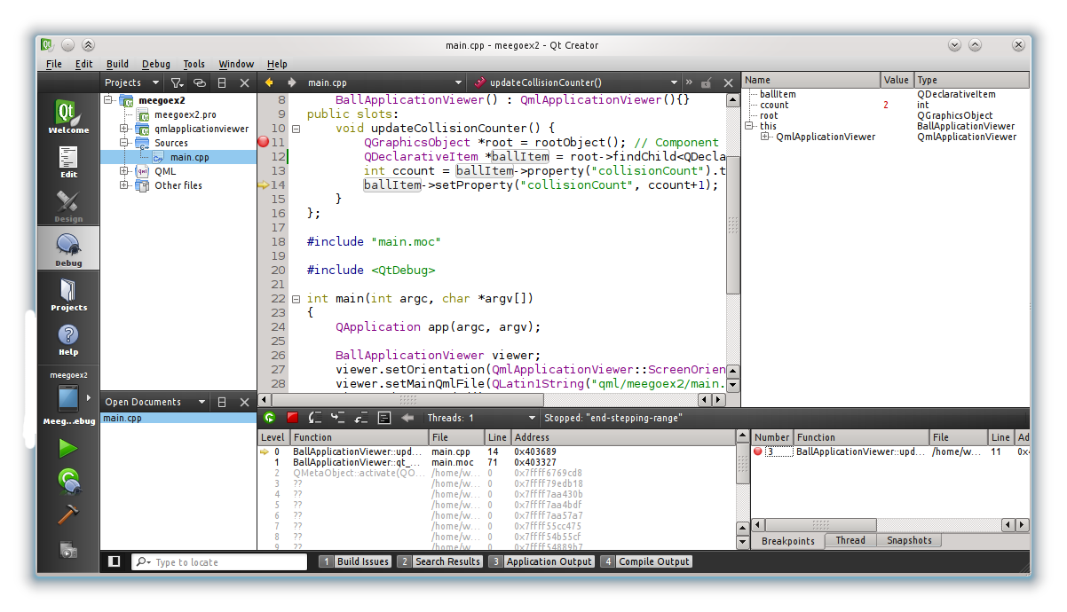
MeeGo Debugging
Notes:
Debugging the remote target is completely transparent to you as a developer. You still have access to locals, call stack, etc
An important factor is that the target now executes the code. This means that the target might run a different binary format. For instance, IA32 (and the host could run IA64), or even Arm instructions.
Endianess, i.e. the order of bytes in multi-byte values, can also differ. This is abstracted away by Qt and Qt Creator, but may still be something that you need to take into account.
Continues

Slide 28
Differences
Desktop
  Native execution on local machine
  No mobility services (in SDK build)
Simulator
  Native execution on local machine
  Simulated mobility services
Target
  Native execution on remote machine
  Actual mobility services
Notes:
To sum things up, you can run your code in three different settings
On the desktop, as an ordinary, native, application. In this mode, there are no mobility services (in the Qt build shipped with the SDK).
In the simulator, as a native application running in a simulated mobility environment. Device-specific screen resolution, sensor input, etc
On a target – virtual or real – natively executed on the target. Here, actual target mobility services are used and the performance of the application is the real performance that you can expect.
Continues

Slide 29
Platform Specific Code
Preprocessor defines identify the platform
  Desktop
    Q_WS_X11 / Q_WS_MAC / Q_WS_WIN
  Simulator
    Q_SIMULATOR
  Target
    Q_WS_X11
Notes:
You can write target specific code. For instance, special handing of the simulator.
There are a set of defines that help you determine the target environment and adapt your code accordingly.

Slide 30
Development Considerations
Overview
Window sizes / orientation
Limited input – touch and no keyboard
Memory availability – RAM and persistent storage
Service availability - sensors
Cost of bandwidth / connection reliability
Media codec availability
Notes:
(These topics are covered in the following slides. You can decide how much details you want to go into during this slide.)
When developing for MeeGo, you are targeting an embedded device. This means that you must pay attention to a few restrictions that your common desktop application does not run into.
One aspect, when designing a user interface, is that the size of your main window often is locked. And that the orientation can change.
You must also take limited input abilities into account. Touch screens require large elements, and keyboardless devices means that users rather pick from a list than type extensively.
Then there are the hardware limitations. Limited memory (both RAM and persistent storage such as FLASH), not all services might be available (e.g. sensors)
In addition to this, bandwidth (downloading and uploading) may be associated with cost and should be kept to a minimum. The network connection can be shaky as well.
Finally, you must plan which codec you rely on if deploying media contents. Licensing is a factor here, so the availability is not always guaranteed.

Slide 31
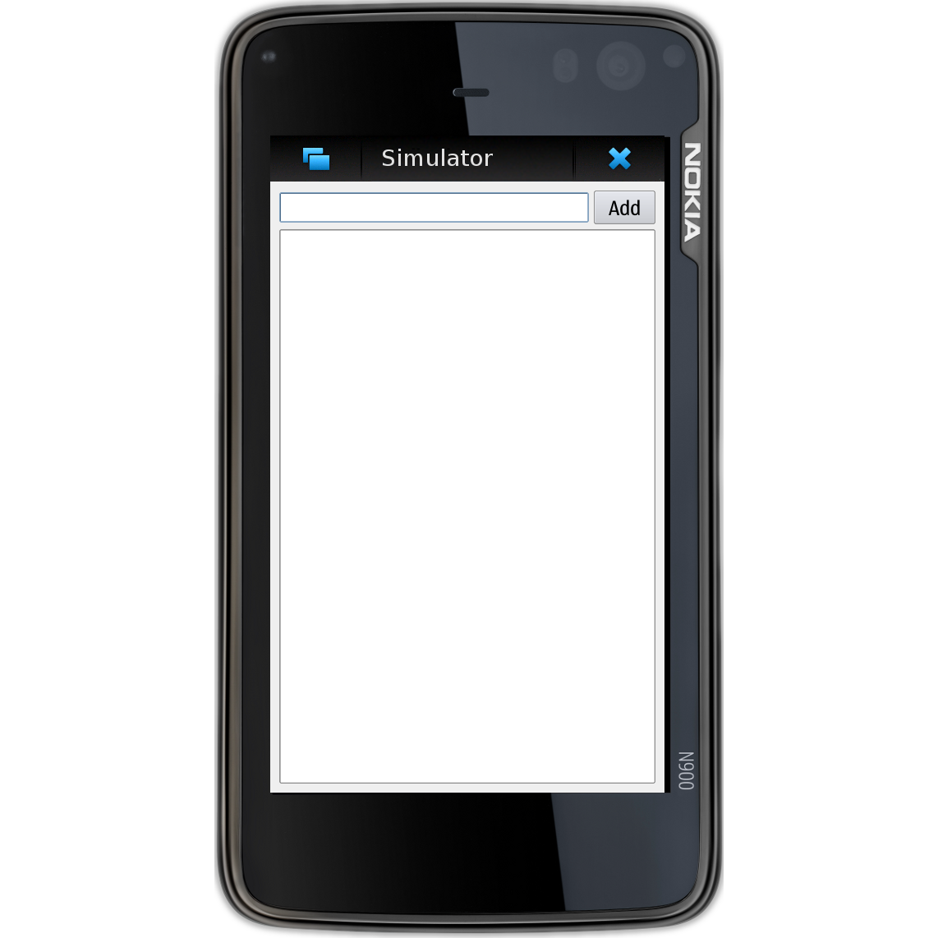
Window sizes
Windows might be freely sized, but can also be locked to the
geometry of the screen
or a top-level window
Your design must be
adapted to this
Notes:
On many machines, the sizes of the windows are less flexible than on a desktop machine.
They may be limited by the screen resolution, or even limited to the screen resolution. In the same vein, dialog boxes may be limited to a fixed width.
The windows can also be forced to change geometry as the device is rotated, unless the application actively locks itself to one orientation (an option i Qt Creator)

Slide 32
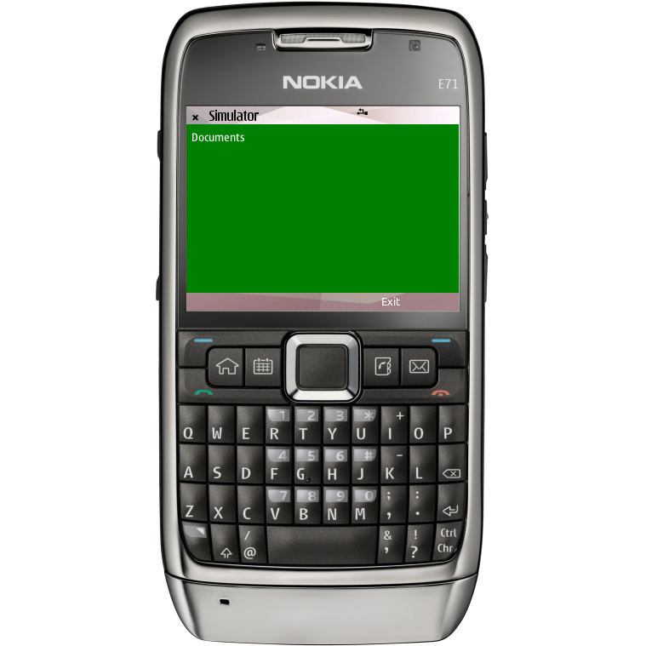
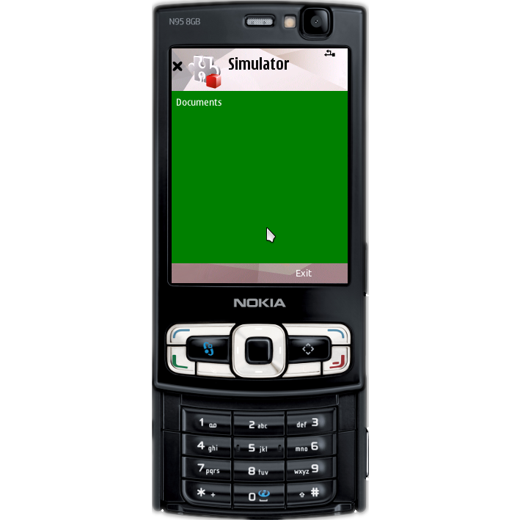
Limited input
Keyboards can be limited to many different configurations
  Keypad
    Predictive text, or
    limited key set
  Touch
    On screen keyboard,
    uses screen estate
  Finger-based touch
    Limited accuracy,
    interactive areas must
    have a minimum
    (touchable) size
Notes:
When developing applications for devices, one of the areas where you can face large differences is user input.
Some devices offer full keyboards, other limited keypads, others no physical keys at all
Input can be made using predictive text, or keyboards that enter one character at first press, then alters the input from further presses. This means that you must be prepared to handle input that changes a lot
When it comes to touch, resistive screens usually offer single point interaction using a stylus – not unlike an ordinary mouse. Capacitive screens usually offer multi point interact, but limits the interaction to fingers. This means that buttons cannot be too small.

Slide 33
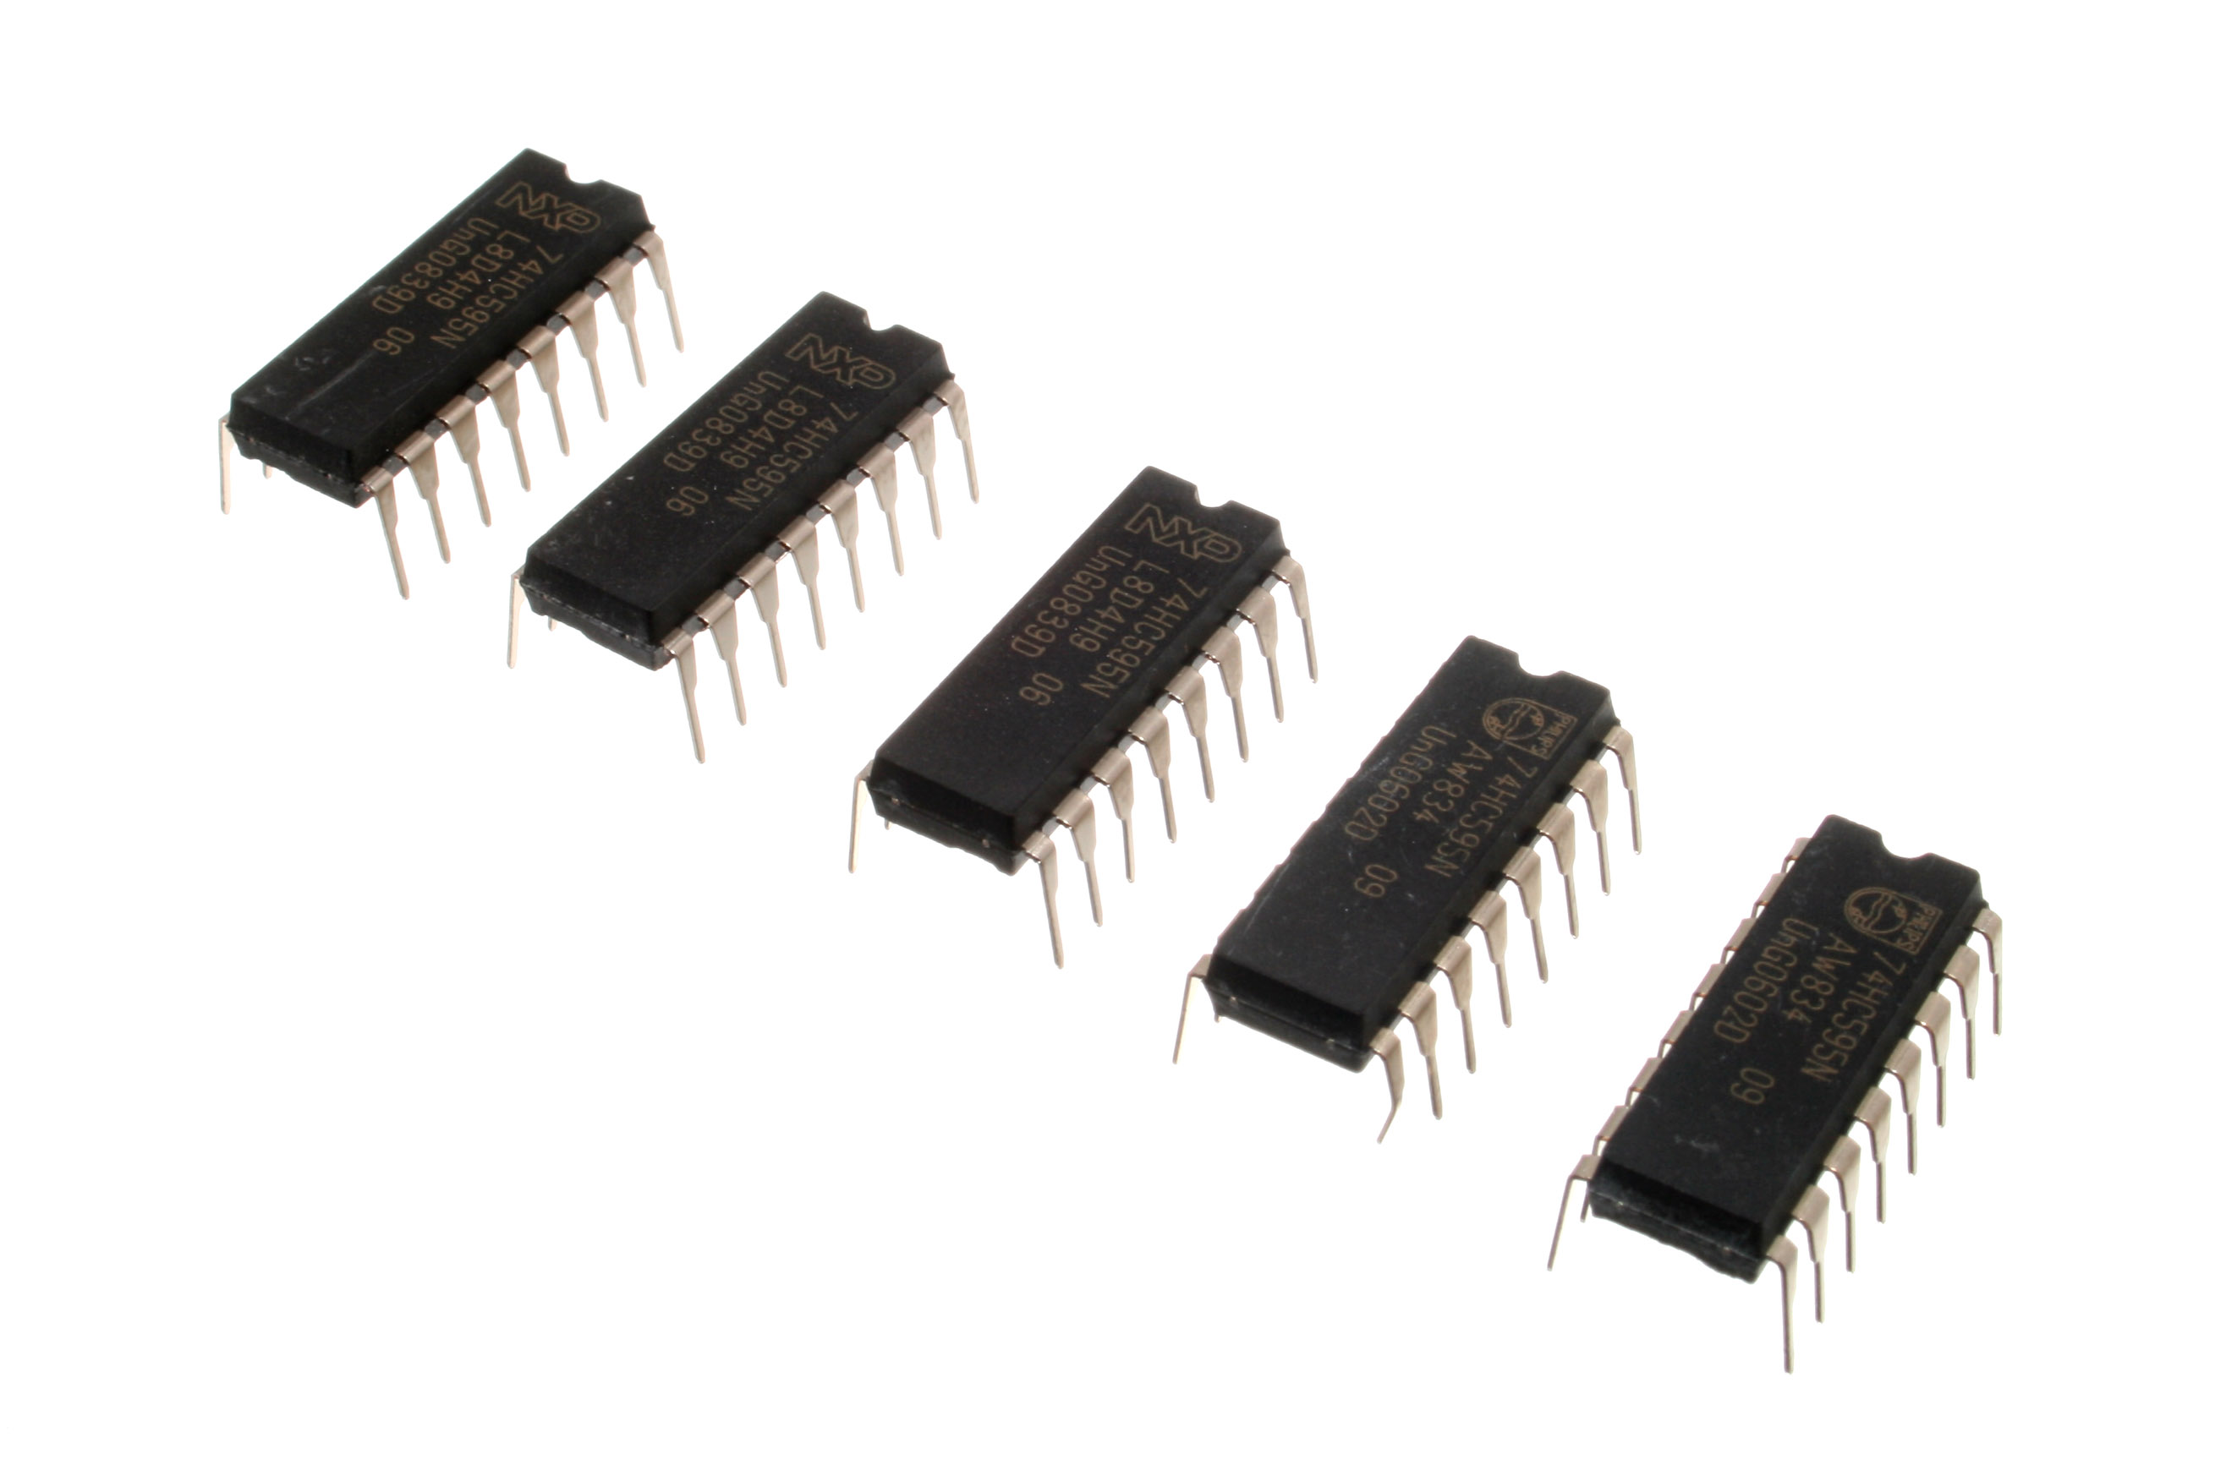
Memory availability
Memory of embedded devices is more limited than on a desktop system
Today, memories can be considered large
It is still important to be smart
  Avoid duplicated data
  Avoid bloated data structures
  Avoid shipping too much data
CC-BY-SA http://www.flickr.com/photos/snazzyguy/3632082991/
Notes:
The memory of embedded devices is more limited than for desktop systems. This is an area which has exploded in recent years, but still worth considering
Both permanent storage (usually FLASH) and volatile memory (RAM) are smaller than for conventional desktops
Try to avoid duplicating data (use model view where applicable), bloated data structures (make sure that you use the information that you store). Also, avoid shipping too much data with your application. This not only reduces the memory footprint, but also the cost of downloading

Slide 34
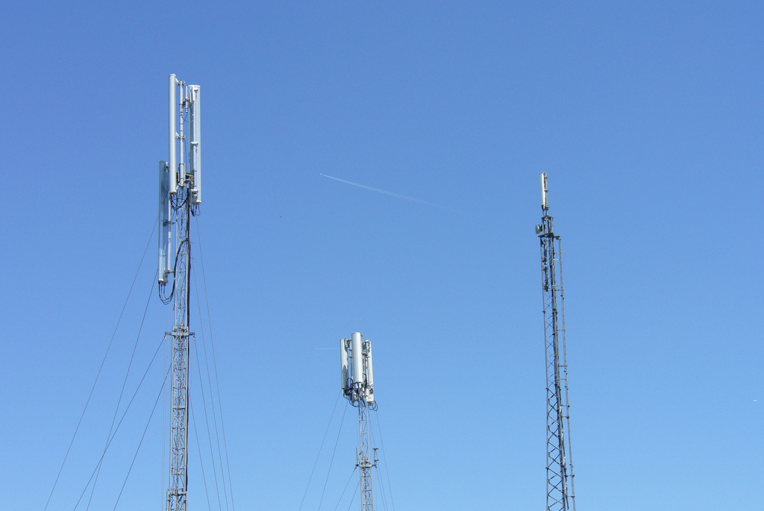
Cost of bandwidth
Mobile devices can be assumed to use expensive and unreliable network connections
  Data traffic roaming can be expensive
  Connections can be
  interrupted at any time
  Bandwidth can be
  limited at times
Let the user control
network access
Support an off-line mode
CC-BY-SA http://www.flickr.com/photos/osde-info/4664431806/
Notes:
Many MeeGo devices can be considered to be mobile. This means that networking must be treated as both unreliable and expensive
To handle the connection quality issue, you must always be prepared for the connection to go down
The available bandwidth can also differ over time, even if the connection stays up
For cost issues it is important that you let your user be in control of the network access. Being able to select an off-line mode, or having the application check before making a network request are kind gestures that improves the user experience

Slide 35
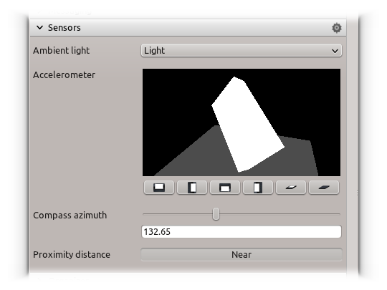
Service availability
Different devices have different features
  Location resolution, and availability
  Orientation sensor availability
  Contacts and calendar availability
  etc
One of the key elements
of the Qt Mobility API is
that it can abstract
services that are optional
Notes:
As MeeGo is targeted for multiple devices, you must prepare your applications to handle different configurations.
For instance, location can be handled using GPS, your current connection or any other technology available. This means that the accuracy, and even availability, of a location varies
Sensors for things such as light, orientation, battery level, etc may or may not be present
Contacts and calendar may or may not be present
...and so on
This is one of the key aspects of QtMobility. It lets you first check if a feature is available, before you use it.

Slide 36

Codec availability
Media playback is an area affected by patents and licenses
  All systems cannot decode all media
  Ensure that codecs are
  available for your target
  platform
  Qt Mobility / MultimediaKit
  relies on gstreamer to
  playback media on MeeGo
  devices
CC-BY-SA
http://www.flickr.com/photos/28653536@N07/2809752964/
Notes:
Another availability aspect that can be crucial is the availability of media codecs
Media encoding is a field riddled with software patents and licensing situations, this means that you must tread carefully
Make sure that the target supports the codecs that you intend to use. Make sure that you have the right to encode your media using that codec. etc
The actual decoding on MeeGo is handled through Qt Mobility / MultimediaKit, which in turn relies on gstreamer, so the available gstreamer plugins determine which media codecs that are available

